Slide 1
S3. Economics of Environment : the Age of Constraints
Limits to human activity
Xavier Timbeau
xavier.timbeau@sciencespo.fr
Anissa Saumtally
anissa.saumtally@sciencespo.fr

Slide 2
Demographics&economics
Welcome to the Anthropocene
The increased pressure on Earth: the Great Acceleration
Boundaries to human activity
Infinite growth in a finite world ?

Slide 3
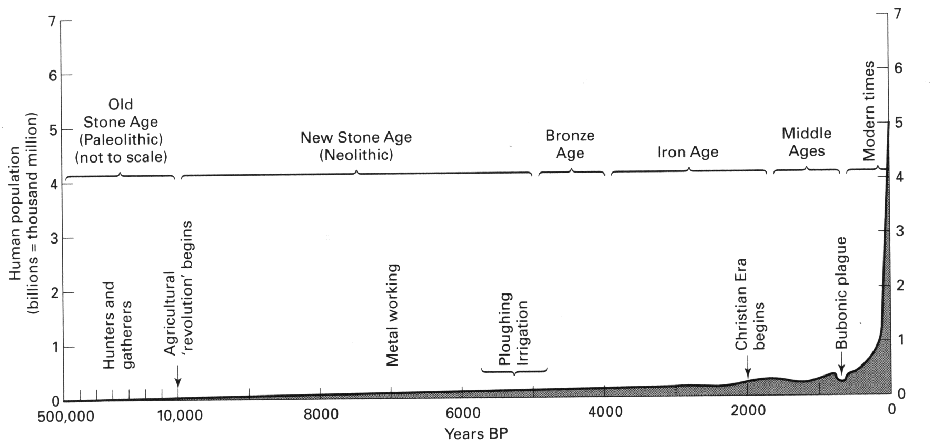

Demographics&economics : More and more humans
Population (in billions) | 1 | 2 | 3 | 4 | 5 | 6 | 7 | 8 | 9
Year | 1804 | 1927 | 1960 | 1974 | 1987 | 1999 | 2012 | 2025 | 2040
Years elapsed | 123 | 33 | 14 | 13 | 12 | 13 | 13 | 15

Slide 4
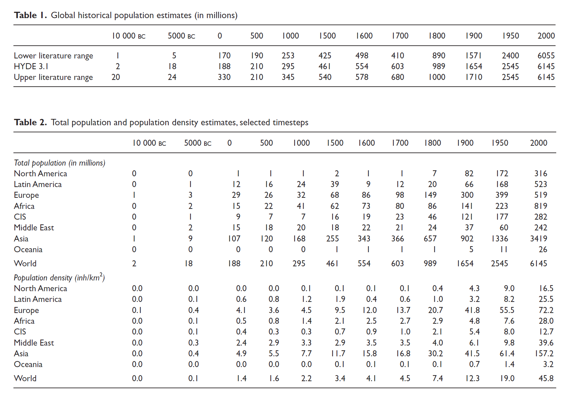
Klein et al (2010) estimation of world population, HYDE 3.1 database
Klein Goldewijk K., Beusen A. and Janssen P., 2010. "Long-term dynamic modeling of global population and built-up area in a spatially explicit way: HYDE 3.1", Holocene, 20(4), 565–573. doi:10.1177/0959683609356587

Slide 5
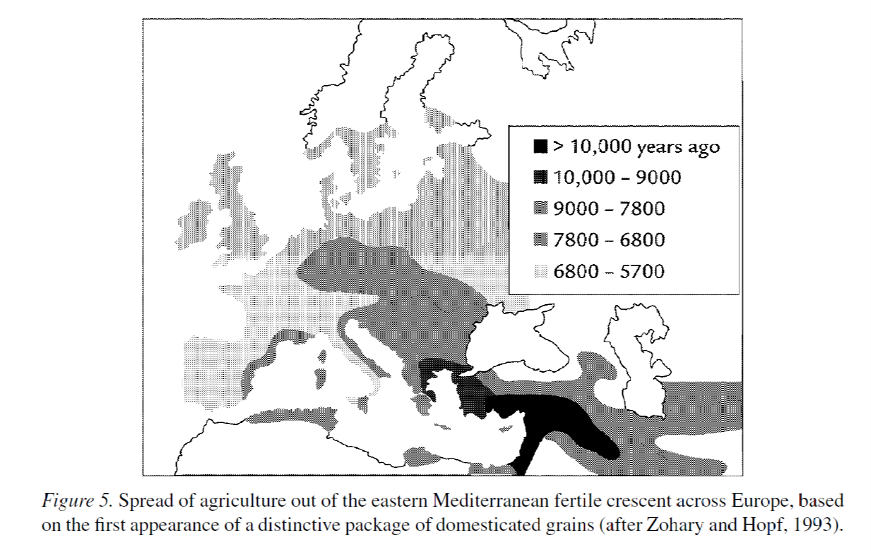
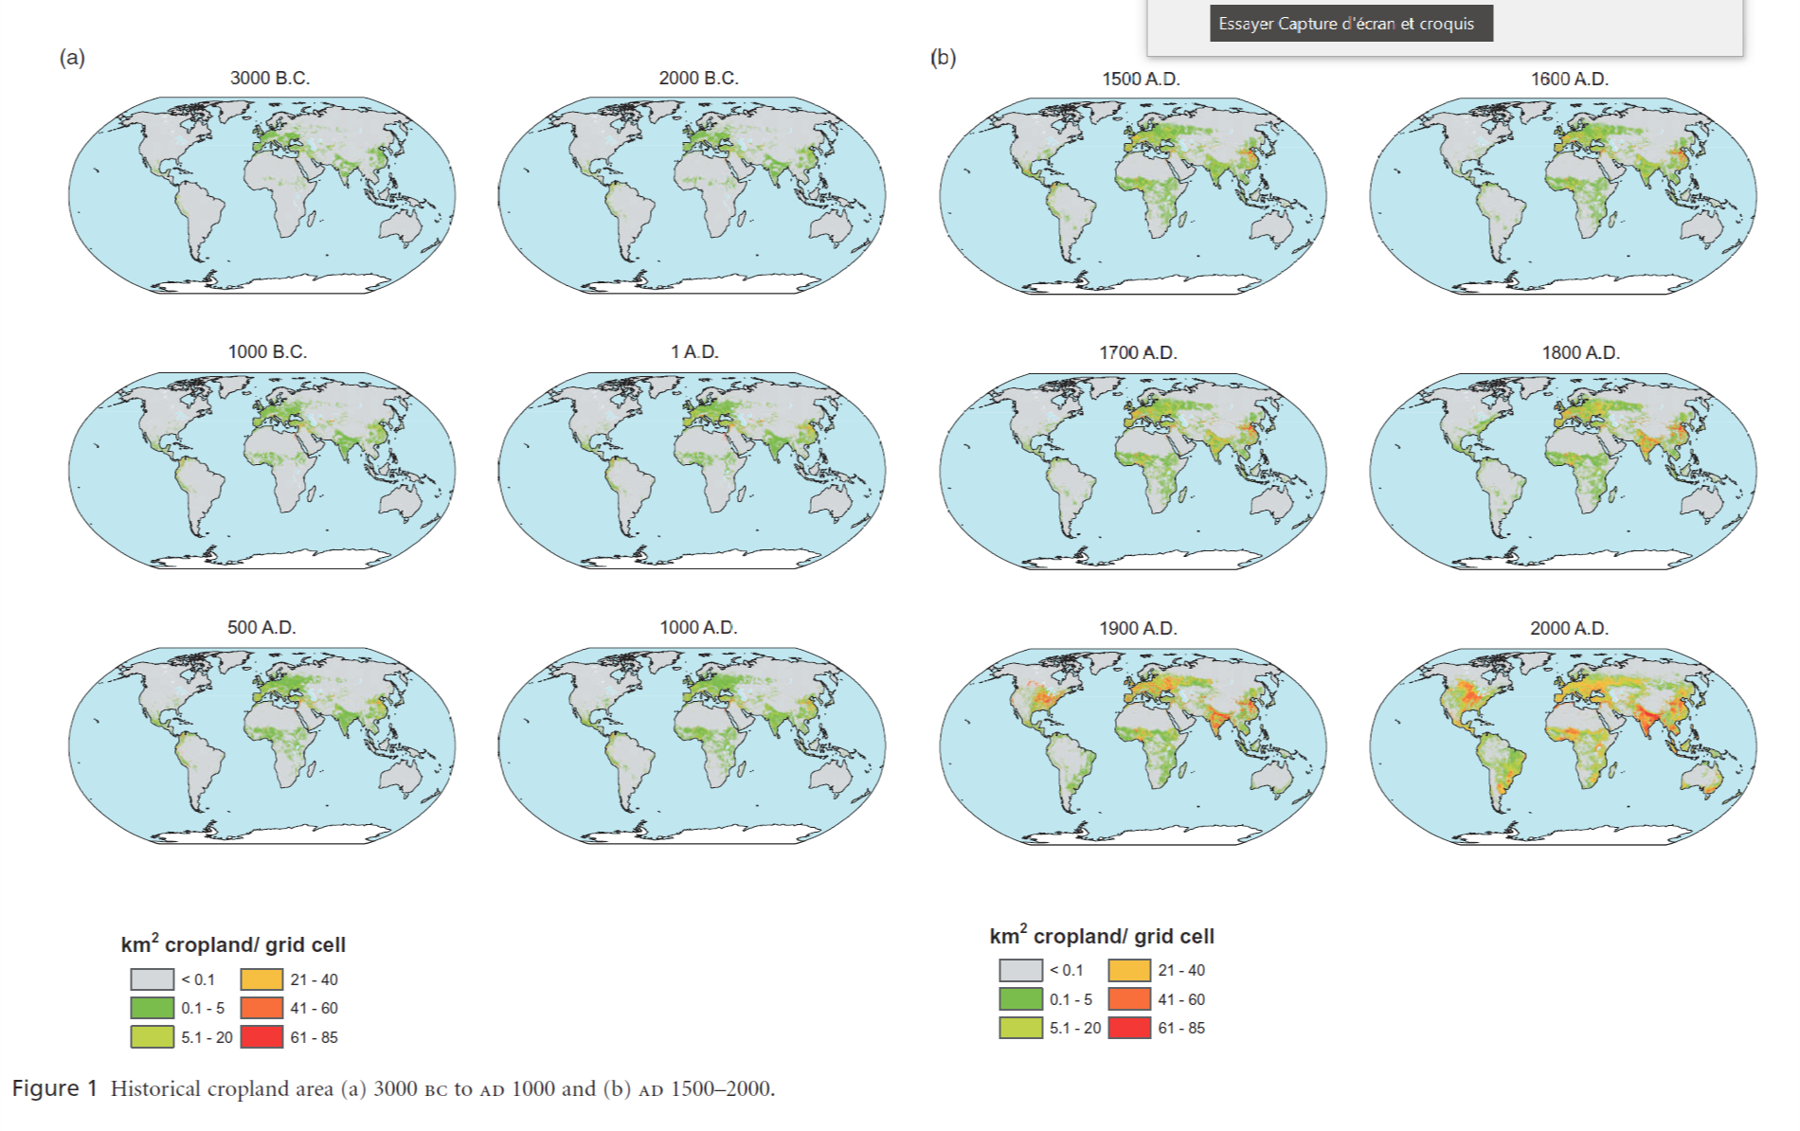
Cropland settlement (HYDE 3.1)
Klein Goldewijk K., Beusen A., Van Drecht G. and De Vos M., 2011. "The HYDE 3.1 spatially explicit database of human-induced global land-use change over the past 12,000 years", Global Ecology and Biogeography, 20(1), 73–86. doi:10.1111/j.1466-8238.2010.00587.x

Slide 6
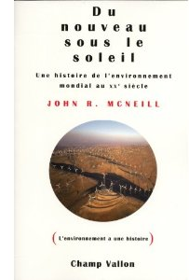
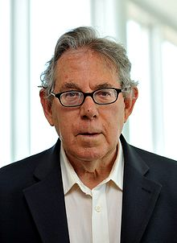
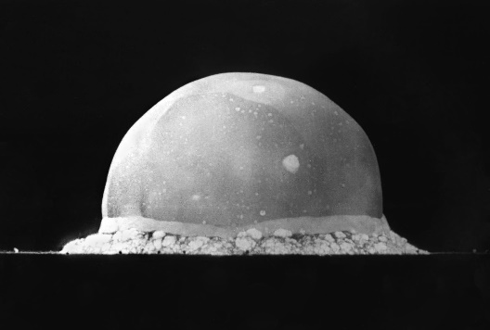
The Trajectory of Anthropocene: The Great Acceleration
Steffen W., Broadgate W., Deutsch L., Gaffney O. and Ludwig C., 2015. "The trajectory of the anthropocene: The great acceleration", Anthropocene Review, 2(1), 81–98.
Initialy published in 2004, following McNeil “Something New Under the Sun: An Environmental History of the Twentieth-Century World”, accounting for quantitative history of human-environment interaction. Updated in 2015, data up to 2010.
  Video version : Welcome to the Anthropocene, http://vimeo.com/39048998
Anthropocene (Paul Crutzen, 2000’s, earlier occurrences in 1938, 1960’s) is a geological period identified as a layer specific to human activity. Layer of radioactive material after nuclear tests and layer of pollution can be measured (stratigraphy).
  Starting date of anthropocene has been proposed to be 1945, first nuclear explosion (Trinity, test before Hiroshima and Nagasaki).
  We’ll talk later of W.F. Ruddiman’s early anthropocene hypothesis

Slide 7
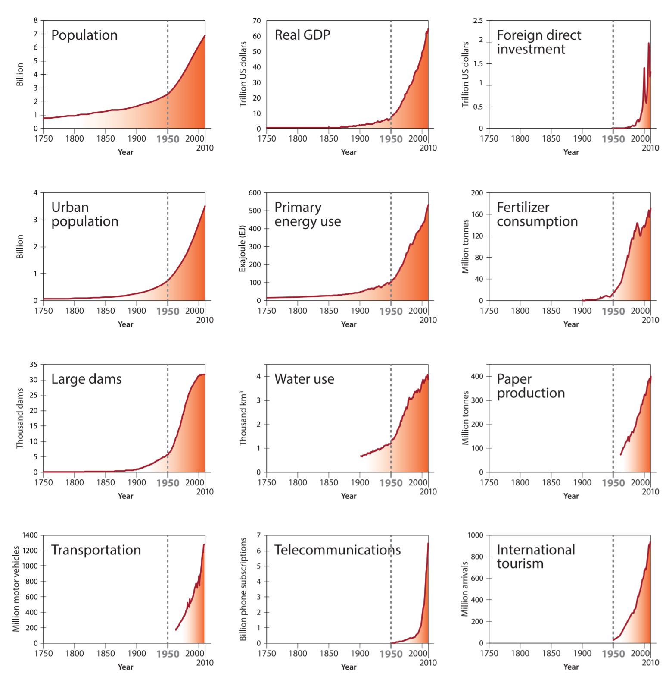

The Great Acceleration: sources
Population increases
  Expected to stabilize to 10b people by 2050
  Confidence interval large [8b,12b]
  Date unsure, could be 2100
  Main uncertainties
    Life expectancy, demographic transition, impact of cure&illness
    Impact of climate change and climate induced violence
GDP per head accelerate
  Main driver, great convergence
  1b people in developed countries
  3b peoples in rapidly growing countries
  3b in emerging countries
  3b more to come in the next decades
Main trends
  1950 acceleration
  Globalisation inducing a new acceleration
  Changing composition
  Some variables have started to plateau

Slide 8
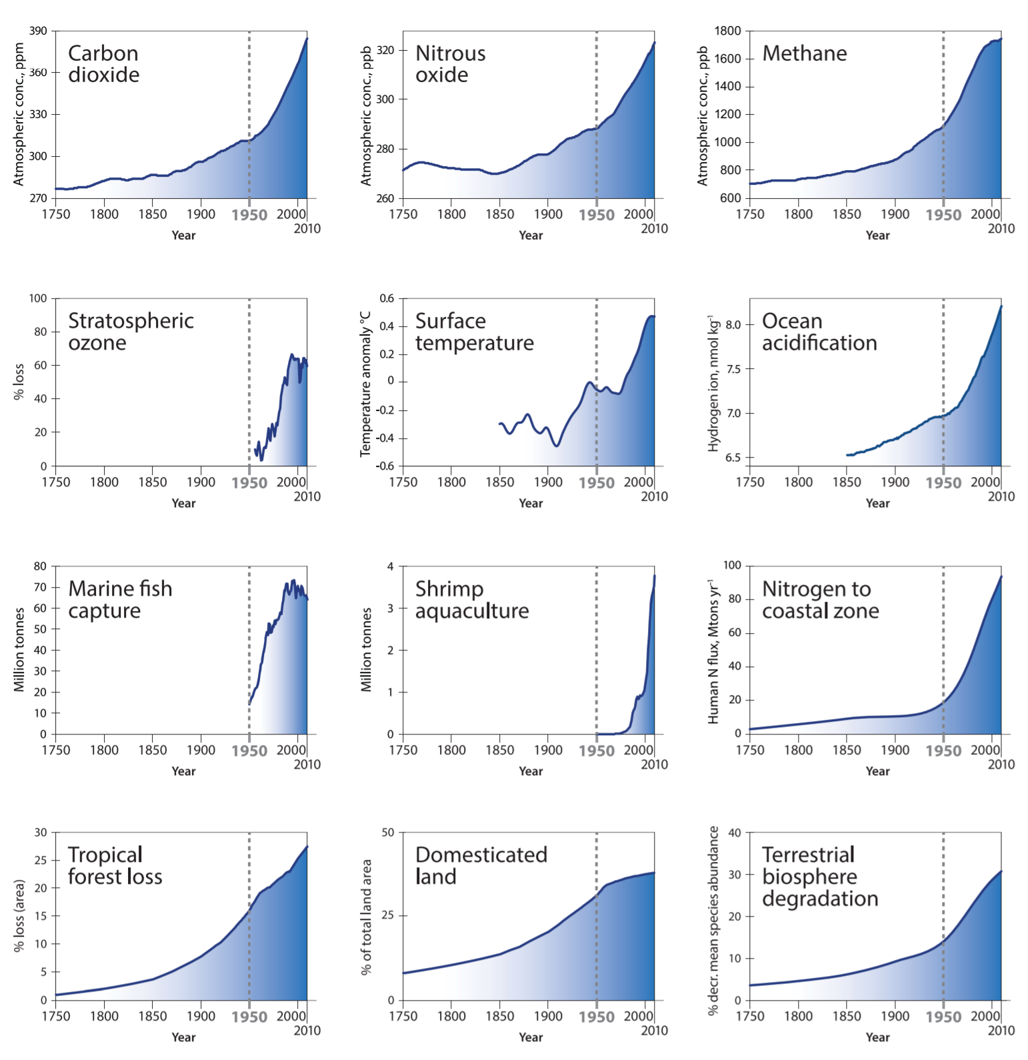

The Great Acceleration: consequences
Consequences on the global ecosystem are massive
  Emissions of GHG [CO₂, CH₄] induce global warming, and climate change
  But also cause acidification of oceans
  Nitrogen and phosphorus open loops are adding stress
  A rapidly changing environment, in amplitude and speed rarely seen in the past is in “global mass extinction” scope
Risks are to cross tipping point
  Irreversible change
  Loss of environmental services
  Fall in support capacity of environment
    Agriculture,
    Climate and infrastructure

Slide 9
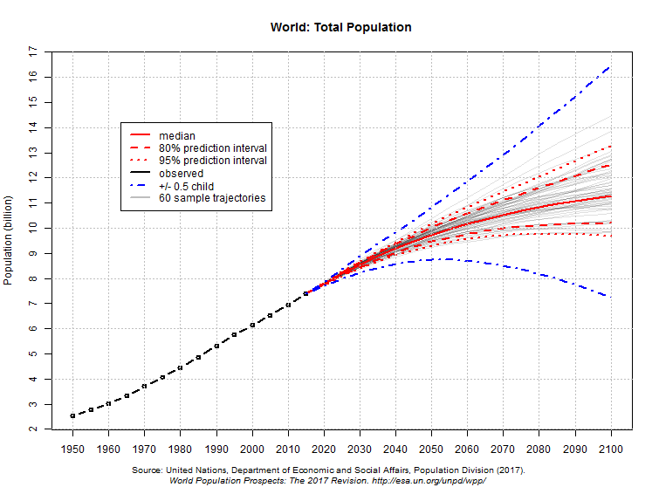
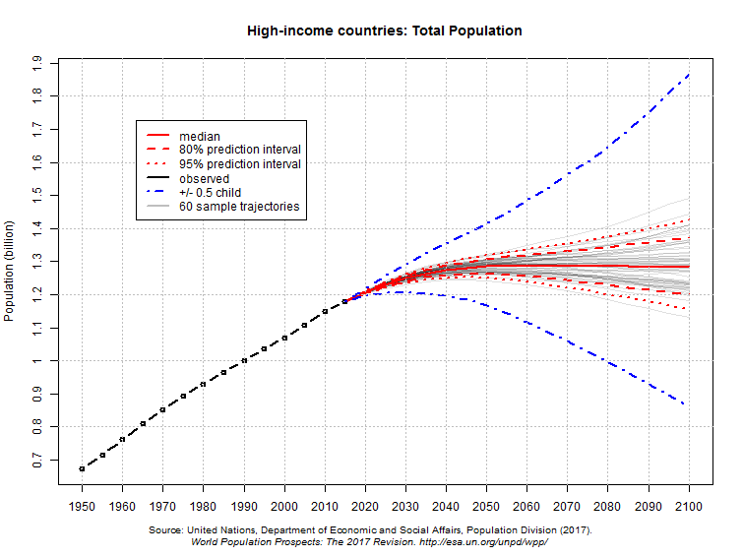
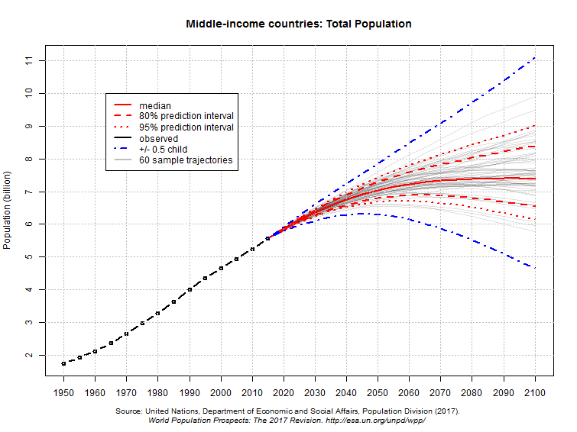
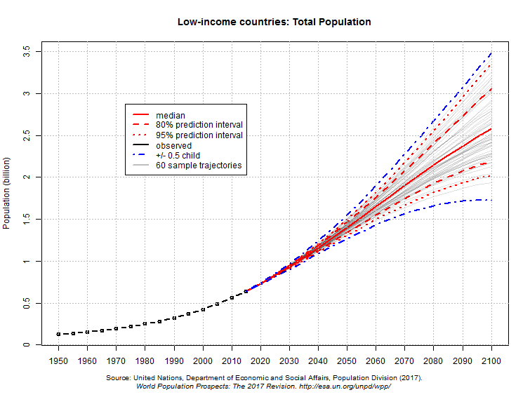
Population projections
2017 UN projections
  Upward revision
  Peak around 11b (10b) by 2100 (2050)
  No wars, no pandemics, no climate change
  Sensitive to fertility

Slide 10
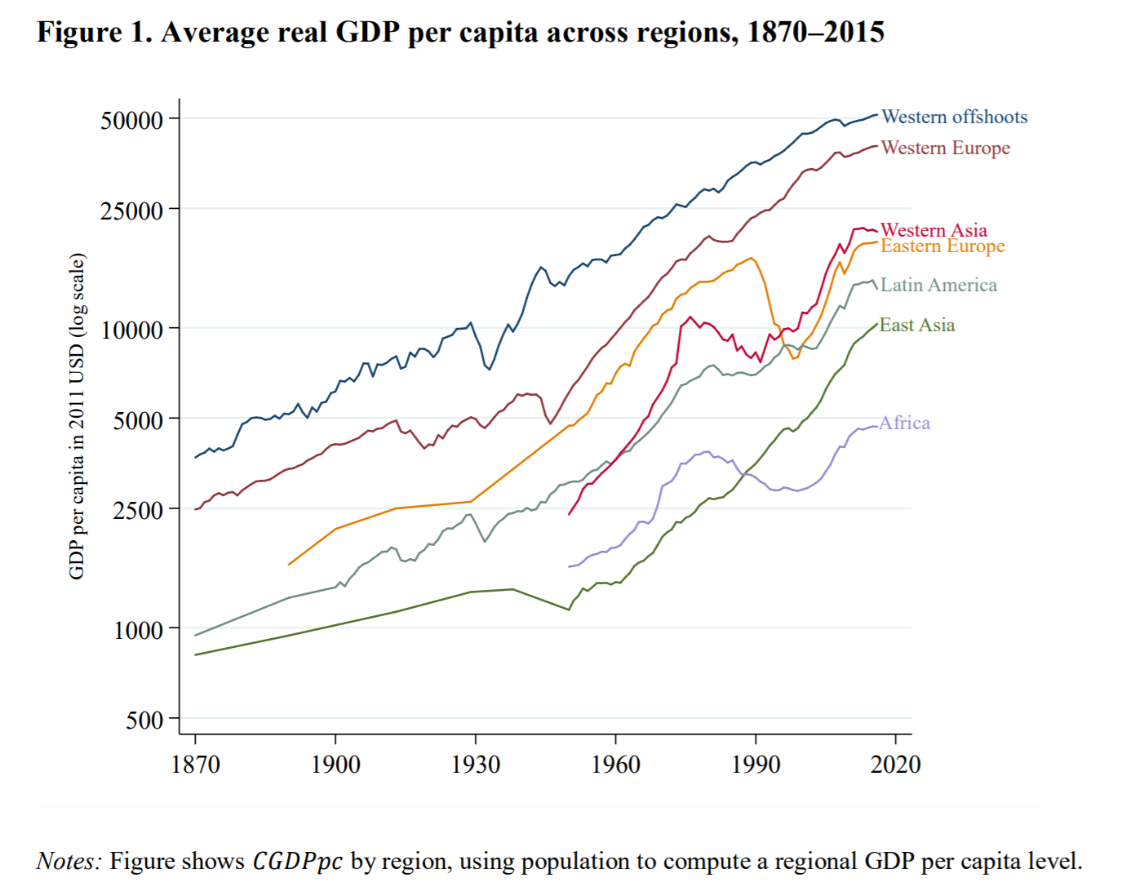
Arithmetic of growth
Since 1950
  World population has doubled,
  Production per head has tripled
  Hence, production has been multiplied by 6
In a close future
  Catching up is the rule
    Today 1b people live as we live (EU+USA+Japan+other developped countries)
    6b are poorer; China+India+other developping countries are growing fast : around 3b people catching up right now
  There is nothing we (in the western world) can (nor should) do
    Convergence, right to development, diffusion of progress
    Best practice, capital, technology at disposal, high yield of investment
  Production per head may triple in the next 50 years
    From 6 000 US$/h/y to more 20 000 US$/h/y
  With equal population, production is going to triple (18 times 1950)
World population should stabilize around 10b people, meaning 50% increase to come
Over the next 50 year, a moderate rate of technical progress may increase human efficiency
  Another doubling of production for 1.5%/y of total factor productivity growth
Bolt J., Inklaar R., de Jong H. and van Zanden J.L., 2018. "Rebasing ‘Maddison’: new income comparisons and the shape of long-run economic development", (January), 67. doi:10.1027/1016-9040.11.4.253

Slide 11
Pressure on earth is increasing and going over the limit
Natural ressources exhaustion
  Depletion of oil, coal, gaz, other fossil energy
  Soil depletion : agriculture; deforesting; erosion
  Renewable ressources consumed beyong sustainable threshold
Pollution
  Saturation of the capacity of the ecosystem (biosphere) to absorb waste produced by human consumption
    Some NGO evalue the process time of 1 year of waste to 4 years : waste accumulation (Wall-e)
  Hydric capacity saturation : pollution over the ability of ecosystem to process it : Aral sea, mediteranean sea tomorrow, South east Asia
  Direct destruction of environment, loss of biodiversity, through destruction of livable zones or direct pollution
Climate change
  Mainly through CO2 emissions, but smoke; dust; methane; airplanes in high atmosphere (water condensation); other GH gazes play a role as well
  Impact is to come; could be huge…unless we are very lucky and negative feedback loops go into motion
  Rapidly changing climate (over a few decades) will have strong consequences

Slide 12
The case for energy
  Rich countries : 1b peoples
    income per head > 25 000 $USppp/y; 4 700 kgoe/h/y
  Developing countries are catching up : 3-4b peoples, 9b by 2050
    income per head ≈ 4 100 $USppp/y; 975 kgoe/h/y
Note : ppp stands for purchase power parity. It is an index which allows for geographical comparison of income by establishing exchange rates based on value of representative baskets of goods. A dollar in China has more value (you can buy more) than a dollar in the USA. ppp indexes are collected and calculated by World Bank
source : WRI, 11/2011

Slide 13







Business as usual illustrated
Today
4.8 toe/y/capita
5.4
1.1 high inc. Gp
1.25 toe/y/capita
11.7 Gt/y
4.9 middle inc. Gp
6.1
0.8 low inc. Gp
0.26 toe/y/capita
0.26
Tomorrow
5.4
1.1 high inc. Gp
4.8 toe/y/capita
4.8 toe/y/capita
36.1 Gt/y
4.9 middle inc. Gp
30.5
0.8 low inc. Gp
0.26 toe/y/capita
0.26
2100
4.8 toe/y/capita
10 high inc. Gp
48 Gtoe

Slide 14
World CO₂ emissions : various sources

Slide 15

Accelerating CO₂ emissions, due to GDP per capita
The Kaya identity: $CO_{2}=Pop×\frac{GDP}{Pop}×\frac{E}{GDP}×\frac{CO_{2}}{E}$
  Accounting ou decomposition identity, no model, no structure in it
  Can be used in various situations with as many terms needed

Slide 16
Share per countries

Slide 17
more and more, richer and richer human being implies more needs
We depend on environmental services
  Water services
    fresh, regular flow, drinkable
  Soils conservation&protection
    vegetation prevents erosion
    mangroove prevents coastal erosion
    Alluvion transports regenerate soils
    Water capture prevent salts to go up (anti salinization)
  Food production
    wild life, plants, bees
  Waste processing
    Closing cycles for nutrinents and essential components
We use a lot of energy
  nearly unlimited solar supply, but it is costly to capture
  Limited but nearly free supply of fossil fuel

Slide 18
A limited carrying capacity
We are (quickly) depleting natural ressources
  Fossils fuels,
  Other minerals
  Soils,
  Wild life, Wild life inhabitat
We are polluting beyond biosphere processing point
  Toxic (chemical, nuclear, biological) waste long (nearly infinite) to process
  We are far from storing long life toxic waste in secure places
We are changing climate
  Main driver is GHG emissions
Boundaries are defined as
  indicators, critical to life, with an anthropogenic evolution
  Subject to tipping points (supposed or expected)
    Threshold unknown or illknown
    Crossing the threshold would be irreversible (or for a long time)
    Consequences of being beyond threshold unknown (untested)
    Not only a threshold but also a speed to the threshold (and beyond):
    reducing adaptation possibility of humans, human societies, ecosystem humans depends on

Slide 19
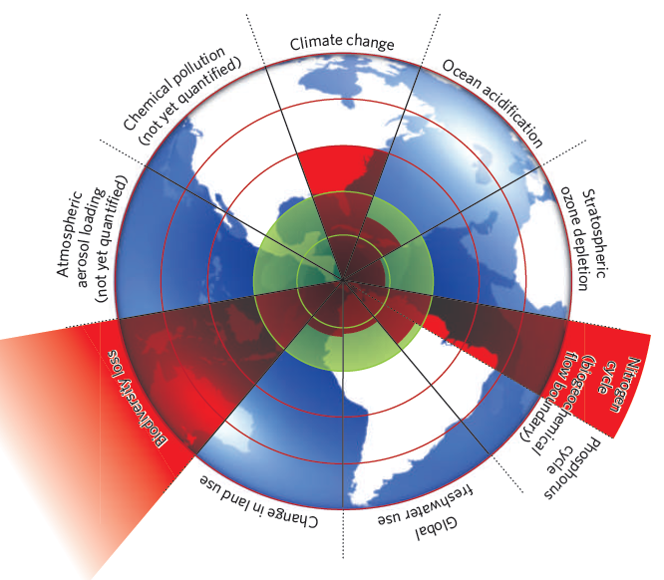
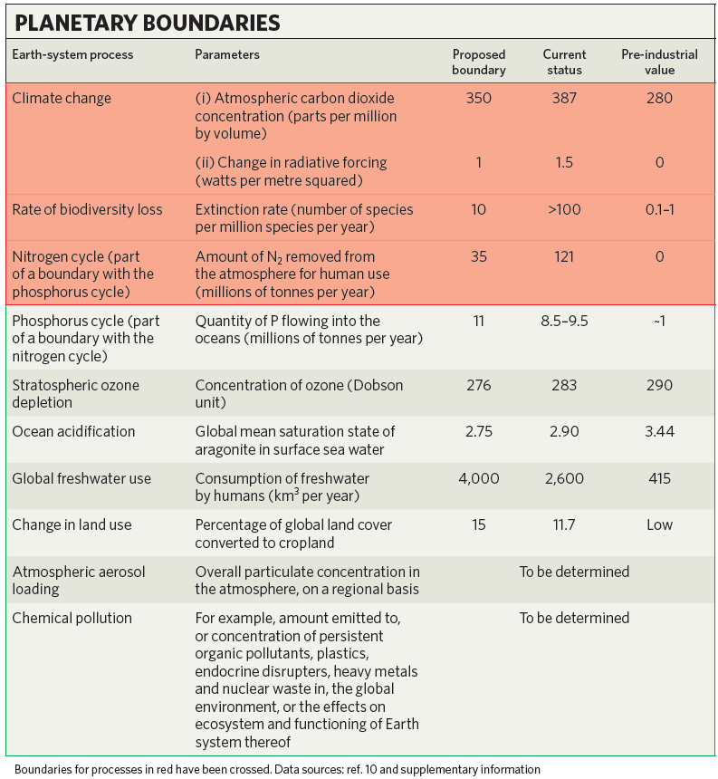
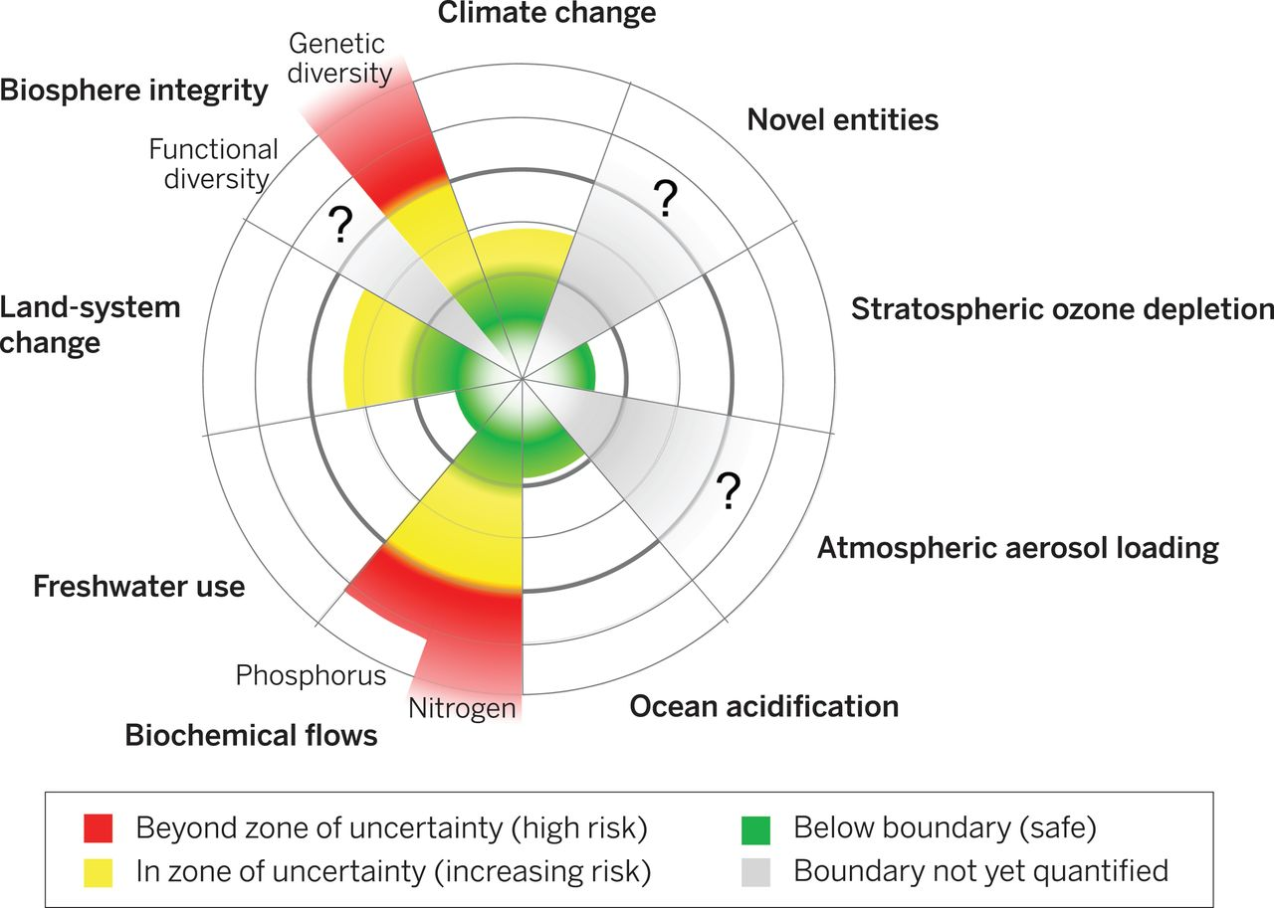
Where to ? Inside earth carrying capacity
Rockström, J., Steffen, W., Noone, K., & Persson, Å., FS. (2009). A safe operating space for humanity. Nature, 461 (September).
Steffen W., Richardson K., Rockström J., Cornell S., Fetzer I., Bennett E., … Carpenter S., 2015. "Planetary boundaries: Guiding human development on a changing planet", Science (New York, N.Y.), 348(6240), 1217.

Slide 20
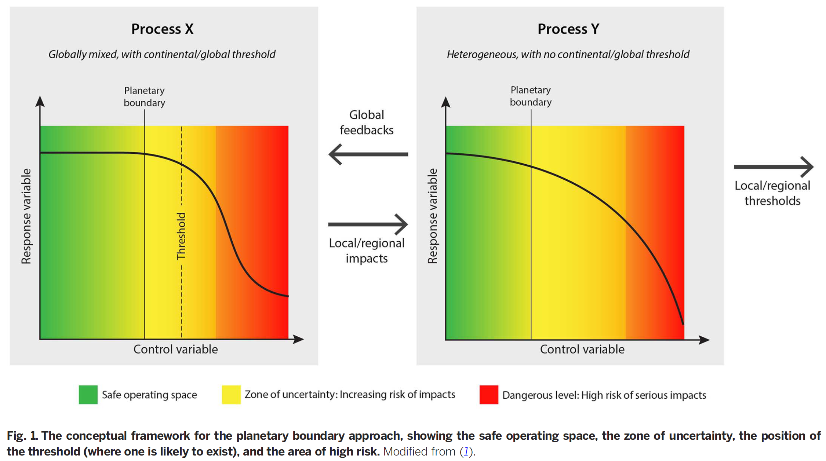
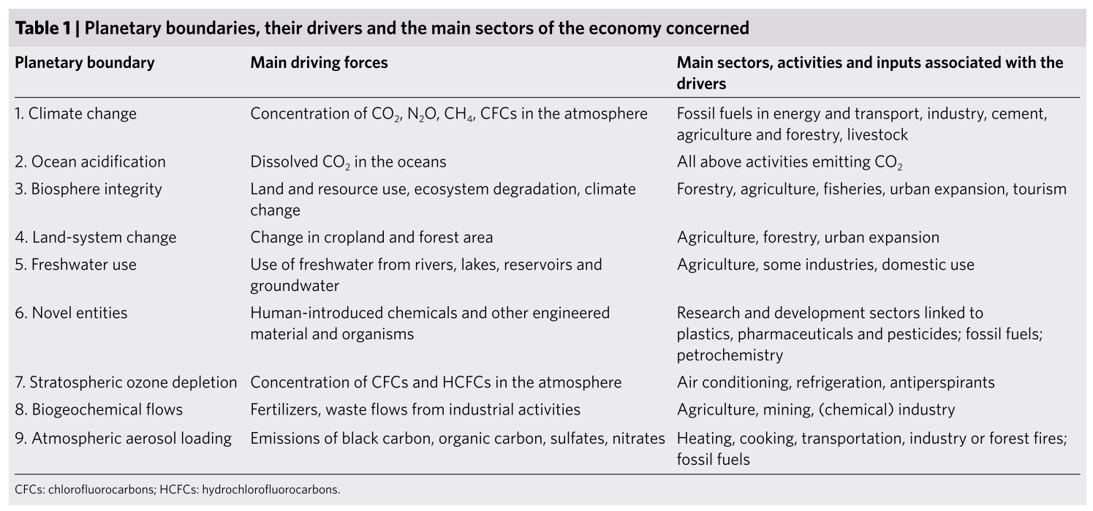
A definition for the limit
Based on radical uncertainty
  Frank Knight
  Black Swan
  What you don’t know you don’t know
  Precautionary principle or Hans Jonas « Our power to do is greater than our ability to forcast » or the end of flat earth
Expected catastrophy, zone to be avoided: conservatism or stewardship
Sterner, T., Barbier, E. B., Bateman, I., van den Bijgaart, I., Crépin, A. S., Edenhofer, O., … Robinson, A. (2019). Policy design for the Anthropocene. Nature Sustainability, 2(1), 14–21. https://doi.org/10.1038/s41893-018-0194-x

Slide 21
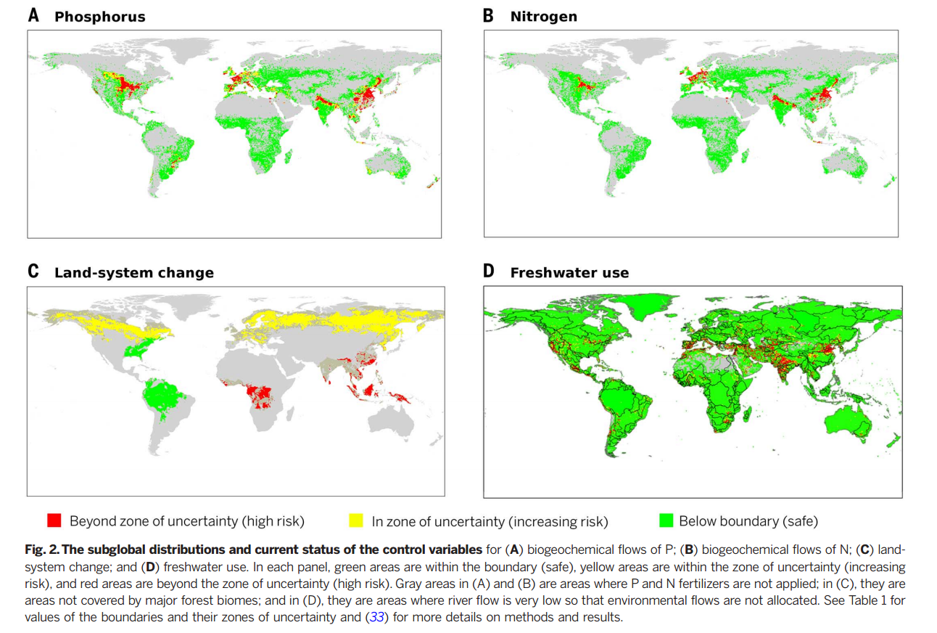
Local (regional) carrying capacity

Slide 22
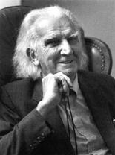
Madman or economist ?
“Anyone who thinks that you can have infinite growth on a planet with finite resources is either a madman or an economist”
Kenneth E. Boulding
The great acceleration: Impact of human activity has increased rapidly since WWII
Climate change is one limit (among other) to human activity on earth
  Carrying capacity
  Carbon budget
Whereas it does not impose zero growth or negative growth, it has strong consequences on economic possibilities
  it imposes a change in relative prices
  it will change the definition of output, modifying relative scarcities
  it will have strong distributional consequences
  it will be a major organizational challenge

